Slide 1

Meet Dave, Dave is moving to Fort Meade, MA with his two daughters and he hopes to send his girls to the best schools in the area.
Image generated by Open AI Dalle 2

Slide 2
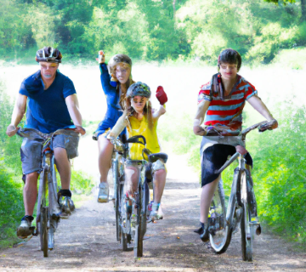
Meet Steve, Steve and his family would love to find a neighborhood that will let them enjoy riding bikes together.
Image generated by Open AI Dalle 2

Slide 3

Meet Jake, Jake wants to get the most for his housing allowance. Should he buy or rent?
Image generated by Open AI Dalle 2

